Slide 1
Capstone Project-3
Mobile Price Range Prediction
Supervised Machine Learning (Classification)
BY
Ankur Shukla

Slide 2

Problem Statement:
Mobile phones have become a necessity for every individual nowadays. People want more features and best specifications in a phone and that too at cheaper prices.
Mobile phones come in all sorts of prices, features, specifications and all. Price estimation and prediction is an important part of consumer strategy. Deciding on the correct price of a product is very important for the market success of a product. A new product that has to be launched must have the correct price so that consumers find it appropriate to buy the product.
In the competitive mobile phone market companies want to understand sales data of mobile phones and factors which drive the prices. The objective is to find out some relation between features of a mobile phone (e.g.:- RAM, Internal Memory, etc) and its selling price. In this problem, we do not have to predict the actual price but a price range indicating how high the price is.
The main objective of this project is to build a model which will classify the price range of mobile phones based on the specifications of mobile phones.

Slide 3
Data Description:
Total Rows= 2000 Total features=21
Battery_power - Total energy a battery can store in one time measured in mAh.
Blue - Has bluetooth or not.
Clock_speed - speed at which microprocessor executes instructions.
Dual_sim - Has dual SIM support or not.
Fc - Front Camera mega pixels.
Four_g - Has 4G or not.
Int_memory - Internal Memory in Gigabytes.
M_dep - Mobile Depth in cm.
Mobile_wt - Weight of mobile phone.
N_cores - Number of cores of processor.
Pc - Primary Camera mega pixels.
Px_height and Px_width - Pixel Resolution Height and width.
Ram - Random Access Memory in Mega Bytes.
Sc_h and Sc_w - Screen Height and width of mobile in cm.
Talk_time - longest time that a single battery charge will last when you are.
Three_g - Has 3G or not.
Touch_screen - Has touch screen or not.
Wifi - Has wifi or not.
Price_range - This is the target variable with value of 0(low cost),1(medium cost),2(high cost) and3(very high cost).

Slide 4
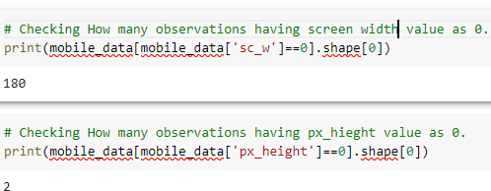

Data Wrangling
Handling Mismatch values in data.
Missing values are imputed using the K-Nearest Neighbors approach where a Euclidean distance is used to find the nearest neighbors.

Slide 5
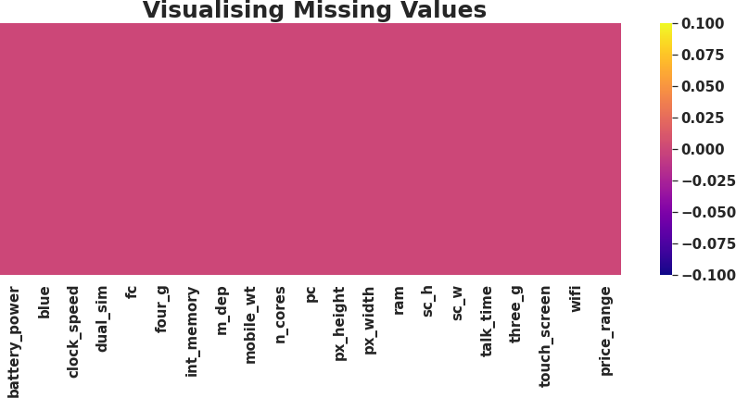

Data Wrangling :
Zero Missing values after handling mismatch from the data.
0 duplicates.

Slide 6
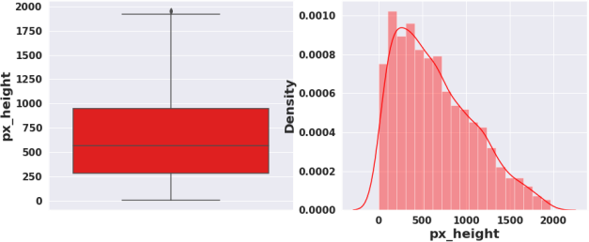
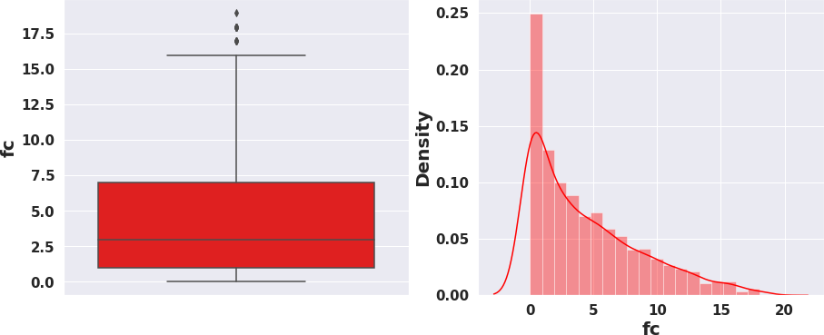
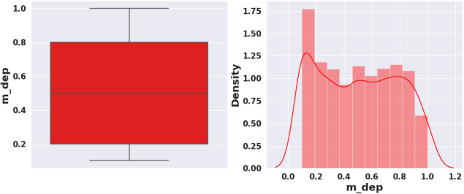
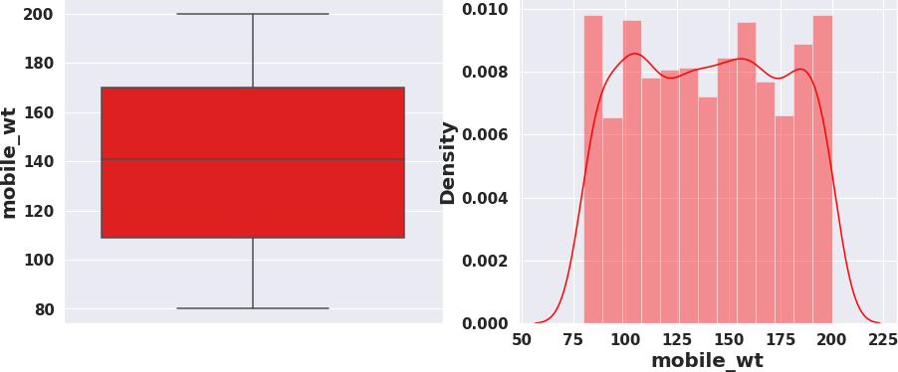
Data Wrangling :
Checking outliers and Distribution of numerical variables

Slide 7
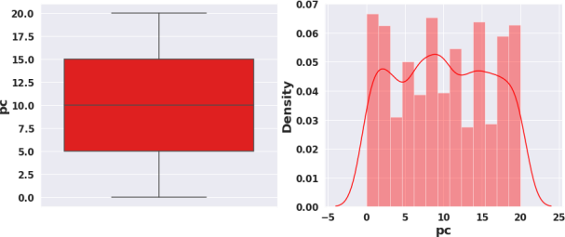
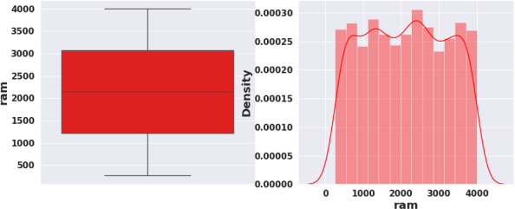
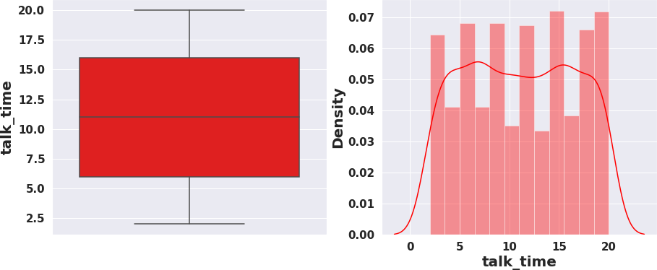
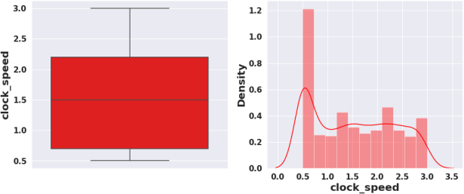
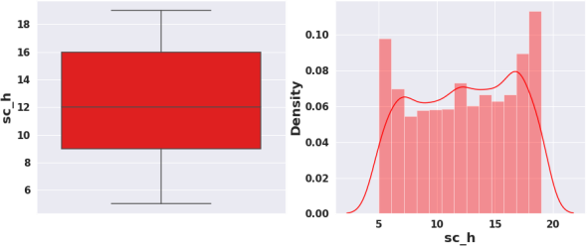
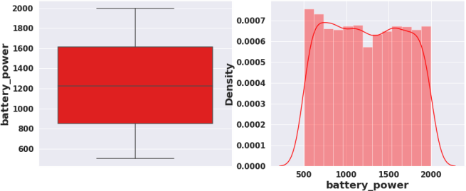
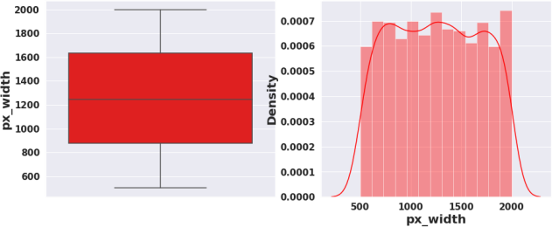
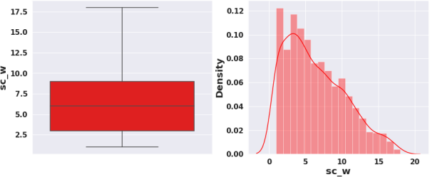
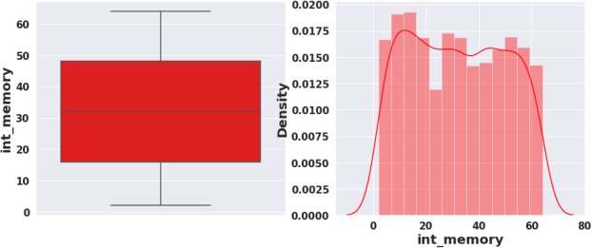
Data Wrangling :

Slide 8
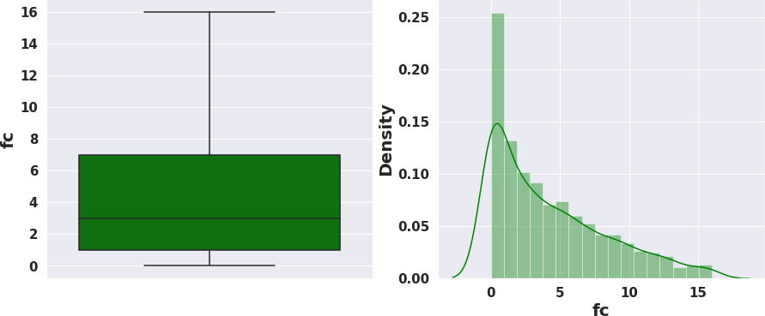
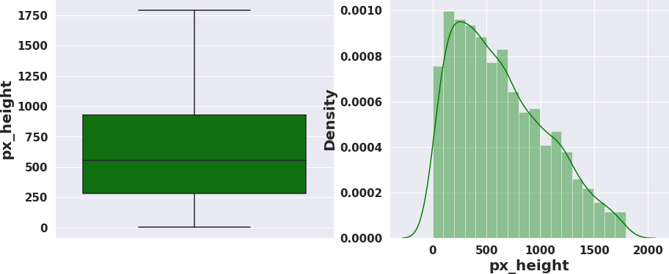
Data Wrangling :
After removal of outliers

Slide 9
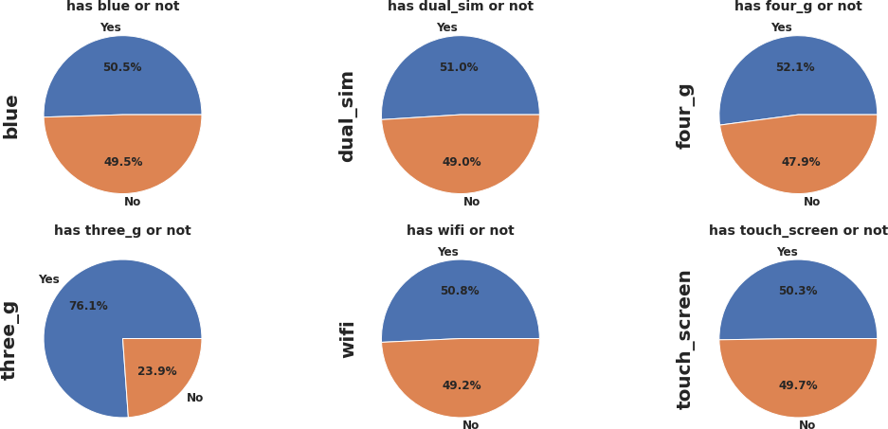
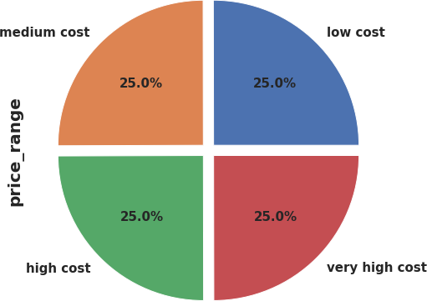
EDA (Exploratory Data Analysis):
Univariate Analysis
Our target variable has equal number of observations in each category. Target variable is equally
distributed.
Percentage Distribution of Mobiles having bluetooth, dual sim, 4G,wifi and touch screen are almost 50 %.
Very few mobiles(23.8%) do not have 3G .

Slide 10
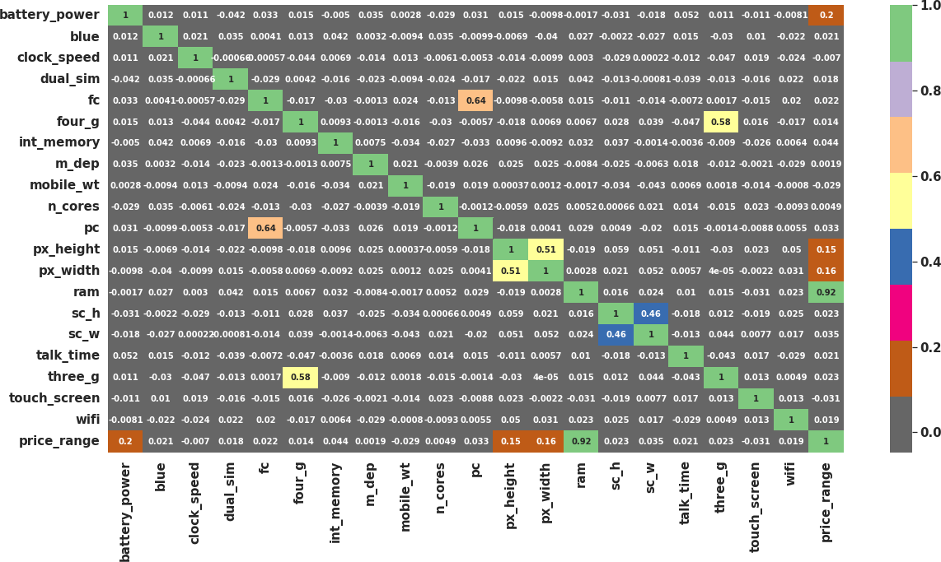
EDA (Exploratory Data Analysis):
Bivariate and Multivariate Analysis: Correlation of independent variable with target variable.
RAM has strong positive correlation with the Price range and we know that Mobiles with high RAM are very costly. Thus RAM increases price range also increase.
Battery power also has positive correlation with the price range. Generally mobiles having high prices comes with good battery power.
Also px_height and px_width (Pixel Resolution Height and width) are positively correlated. Generally High price range mobiles have good resolutions.
Four_g and Three_g are highly positvely correlated. Nowdays most of the smart mobiles has both type of options. This could be the reason that they are correlated.
primary camera i.e pc and front camera fc are positively correlated.
sc_h and sc_w are positively correlated.

Slide 11
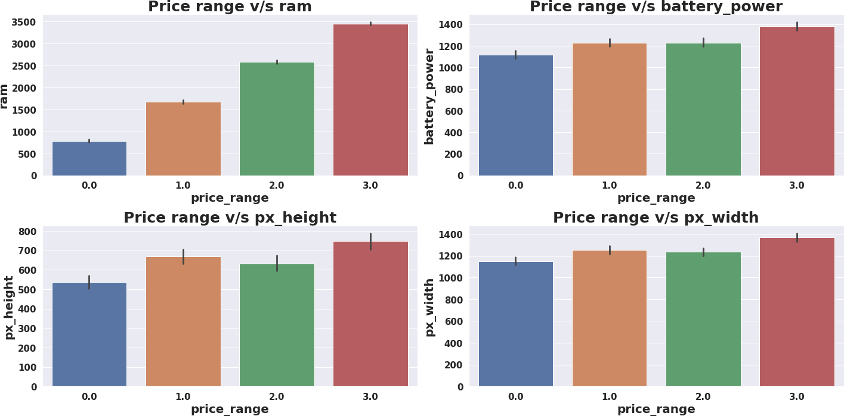
EDA (Exploratory Data Analysis):
Bivariate and Multivariate Analysis:
Mobiles having RAM more than 3000MB falls under Very high cost category. As RAM increases price range also increases.
Mobiles having RAM less than 1000 MB falls under low cost category.
Mobiles with battery power more than 1300 mAh has very high cost. And Mobiles with battery power between 1200 and 1300 mAh falls under medium and high cost category.
Mobiles with more than 700 pixel height and width more than 1300 has very high cost.

Slide 12
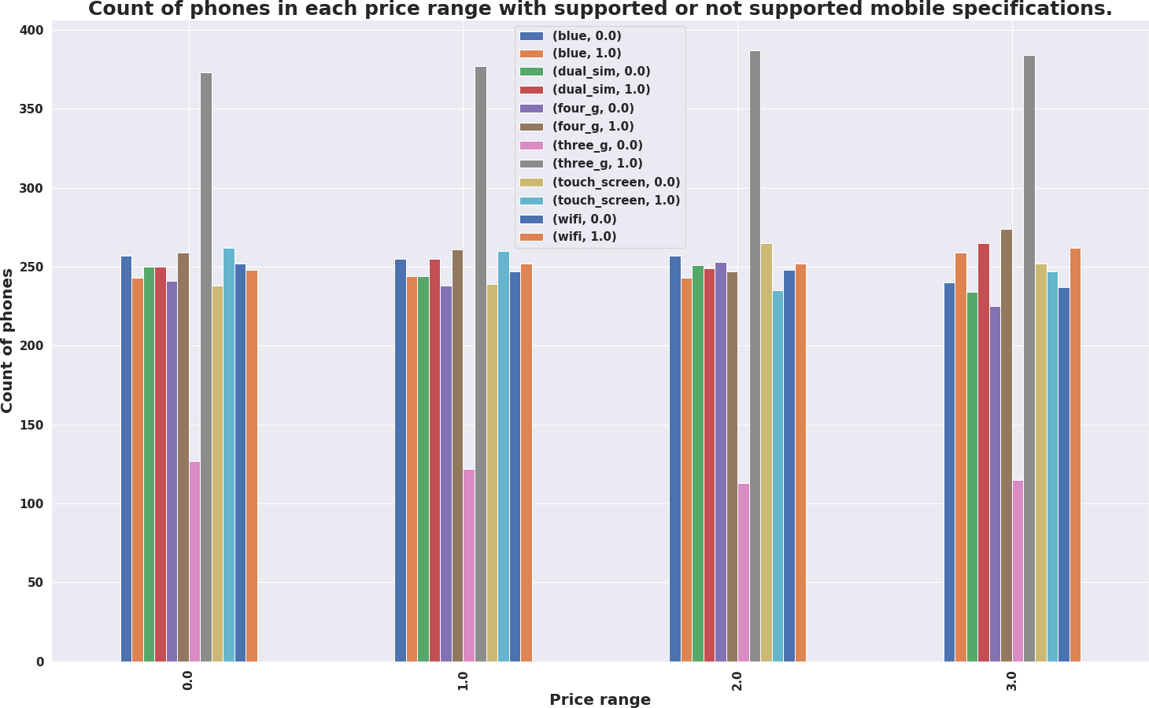
EDA (Exploratory Data Analysis):
Bivariate and Multivariate Analysis:
Each price range category has equal number of mobiles phones having both supporting and non supporting specifications.

Slide 13
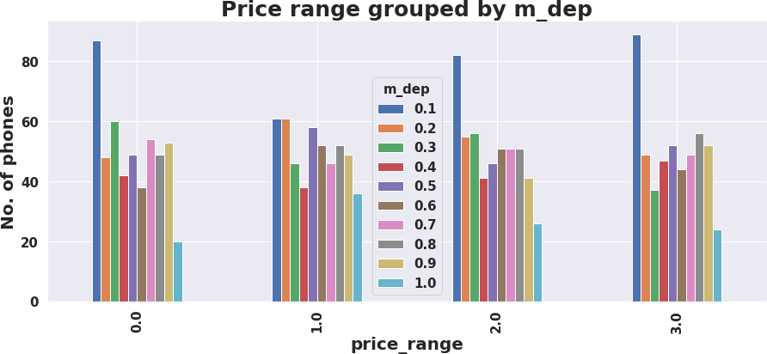
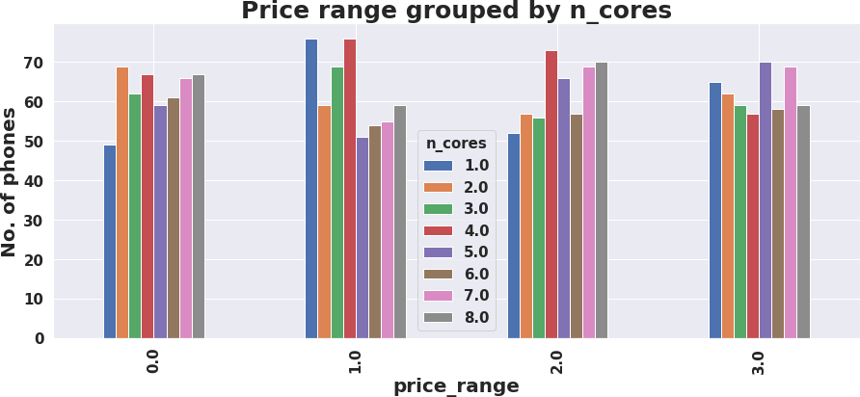
EDA (Exploratory Data Analysis):
Bivariate and Multivariate Analysis:
There are very few mobiles in price range 0 and 1 with lesser no of cores.
Most of the mobiles in price range 2 and 3 are with high no of cores.
Number of phones with less thickness is high and count of phones with high thickness is low.

Slide 14
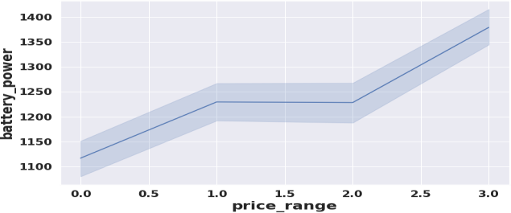
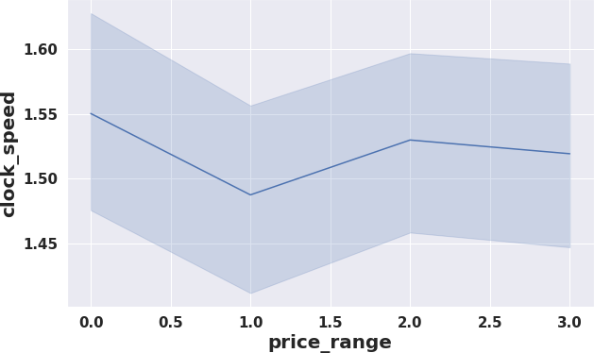
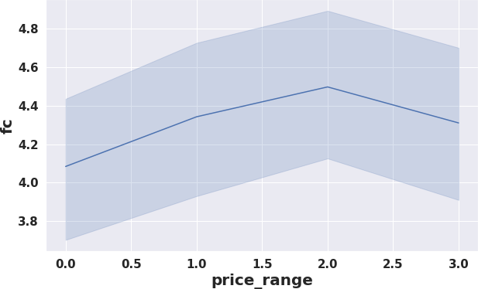
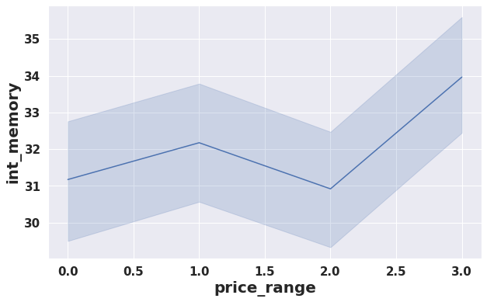
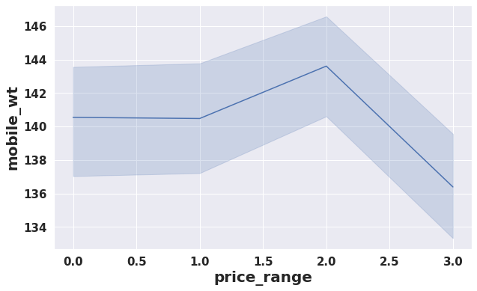
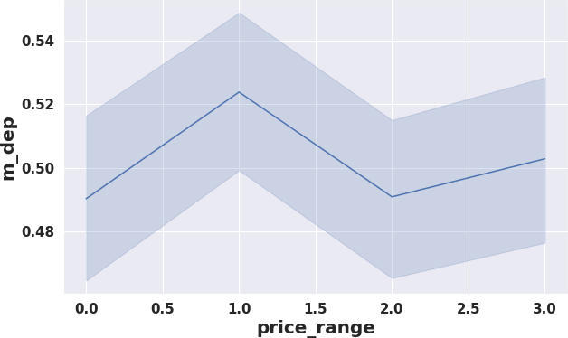
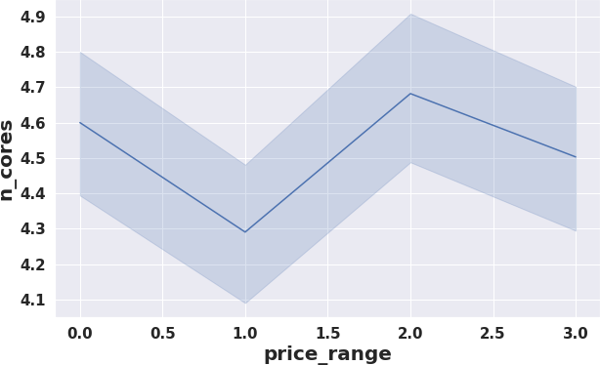
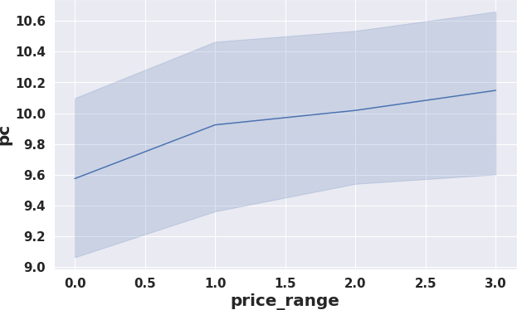
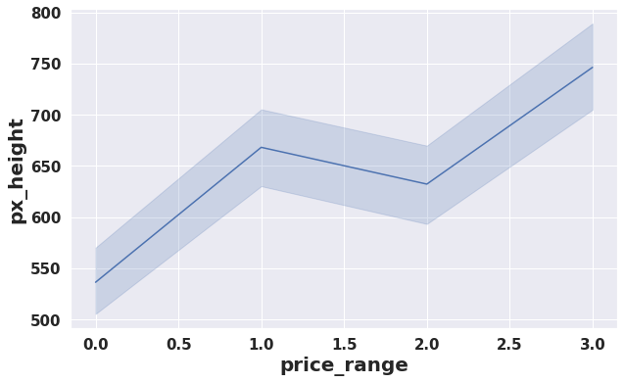
EDA (Exploratory Data Analysis):
Bivariate and Multivariate Analysis: Different trends of price range v/s other features

Slide 15
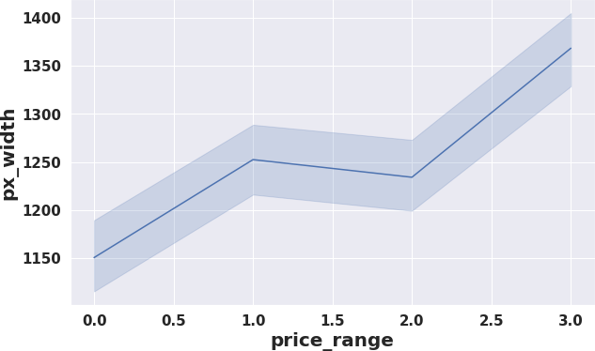
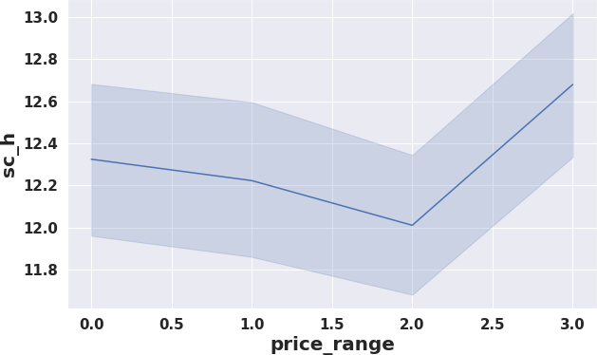
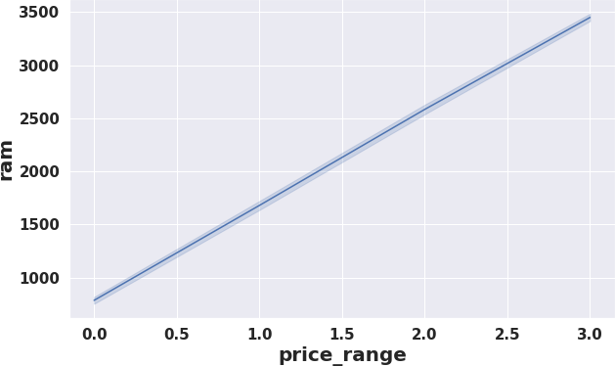
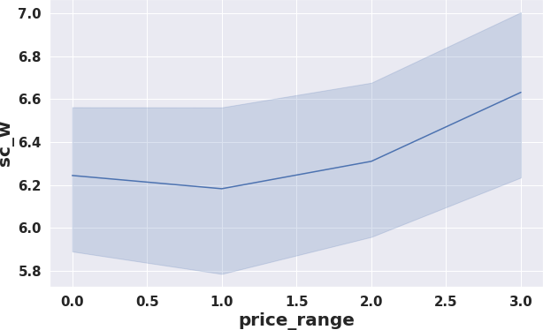
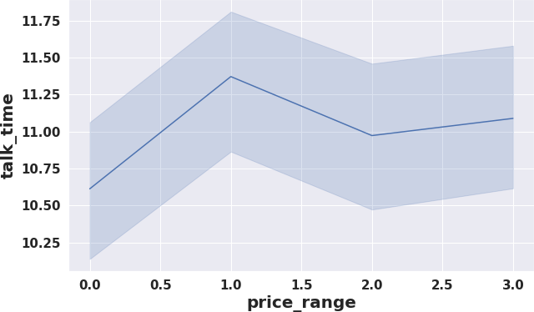
EDA (Exploratory Data Analysis):
Bivariate and Multivariate Analysis: Different trends of price range v/s other features

Slide 16
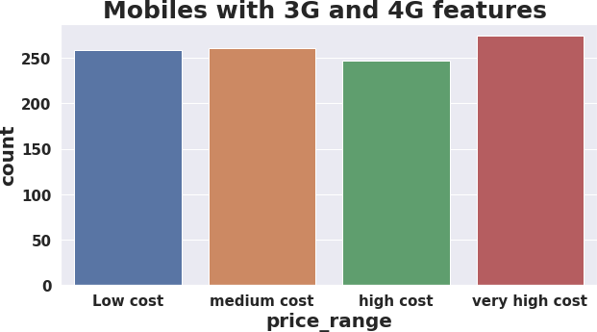
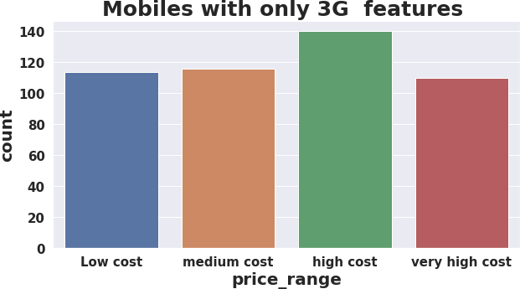
EDA (Exploratory Data Analysis):
Bivariate and Multivariate Analysis:
Count of mobiles with 3G and 4G is high in very high cost category.
Count of mobiles with only 3G feature is high in high cost category.

Slide 17
Model Selection and Evaluation :
Before building a models we performed the train test split. We kept 25% of the data for test and remaining 75% of the data for training the model.
We compared 6 algorithms and evaluated them based on the overall accuracy score and the recall of the
individual classes.
Accuracy is the ratio of the total number of correct predictions and the total number of predictions.
The recall is the measure of our model correctly identifying True Positives.
Decision Tree
Random Forest classifier
Gradient Boosting Classifier
K-nearest Neighbor classifier
XG Boost Classifier
Support Vector Machine(SVM)

Slide 18
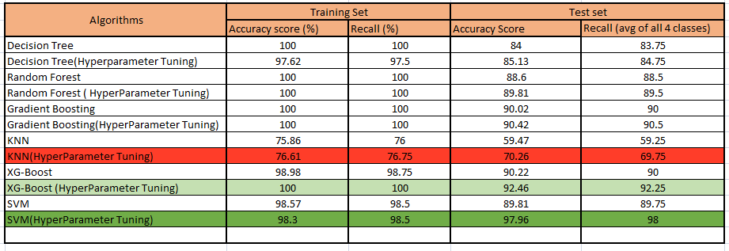
Evaluation of models:
Best model came out to be SVM after hyper-parameter tuning.
XG boost (Hyper-parameter Tuned) can be considered as the second most good model.
KNN performed very worst.

Slide 19
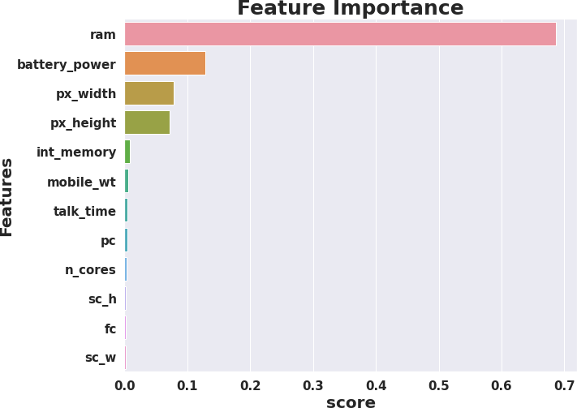
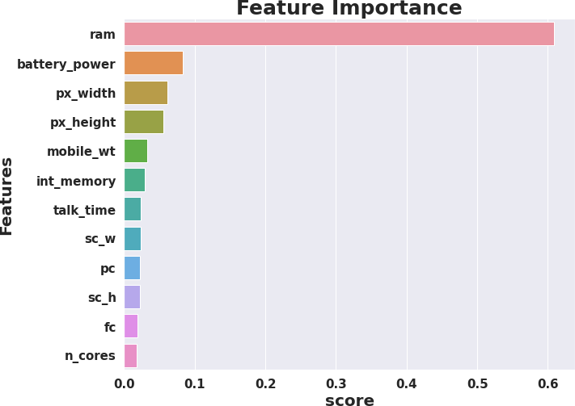
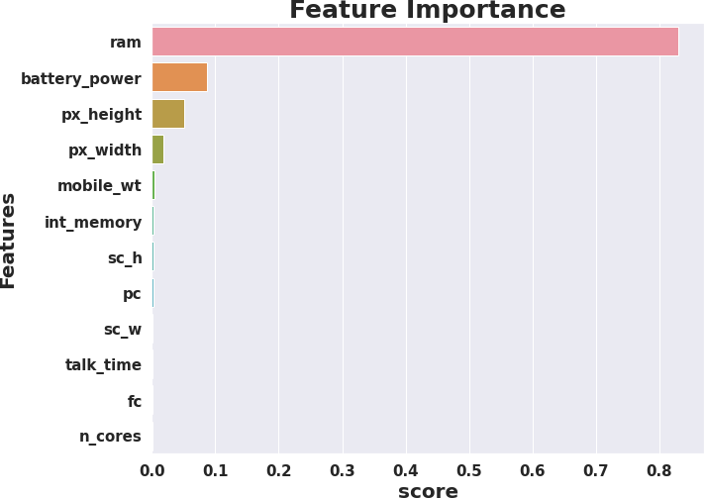
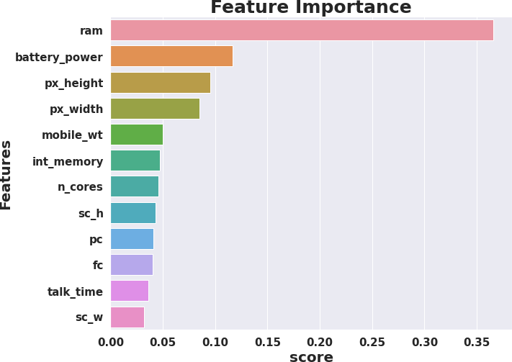
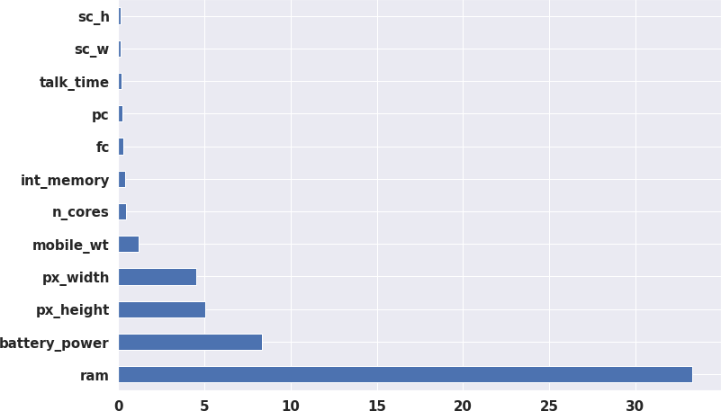
Feature importance's :
Decision Tree
Random Forest
Gradient Boost
XG boost
SVM
RAM, Battery Power, Pixel height and weight contributed the most in predicting the price range.

Slide 20
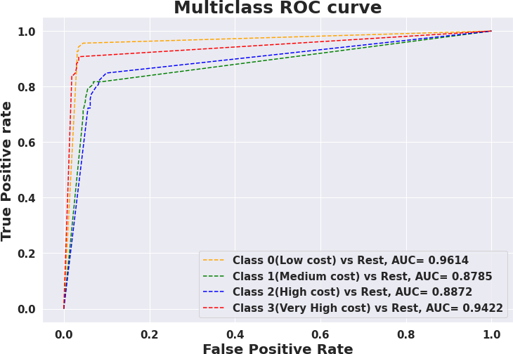
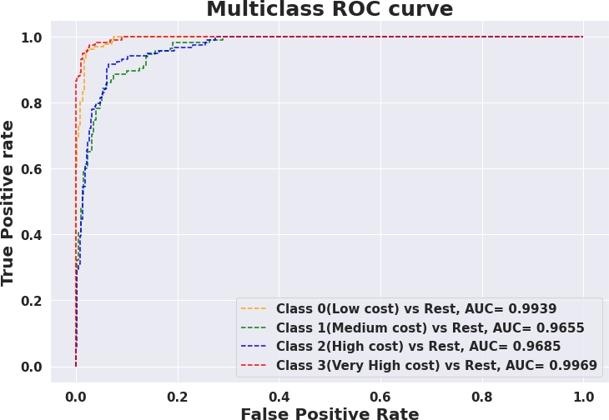
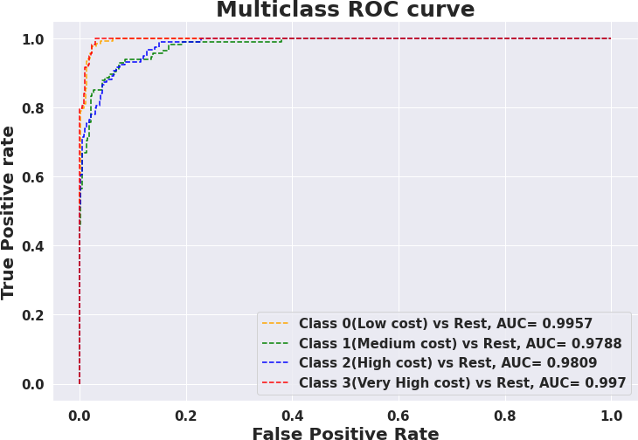
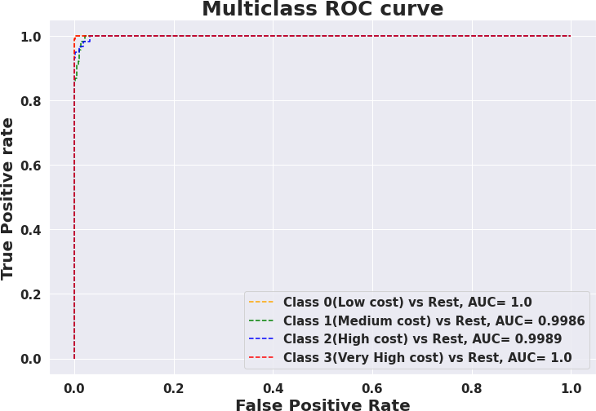


AUC ROC curves:
Decision Tree
Random Forest
Gradient Boost
XG boost
SVM
KNN

Slide 21
Conclusions:
We Started with Data understanding, data wrangling, basic EDA where we found the relationships, trends between price range and other independent variables.
We selected the best features for predictive modeling by using K best feature selection method using Chi square statistic.
Implemented various classification algorithms, out of which the SVM(Support vector machine) algorithm gave the best performance after hyper-parameter tuning with 98.3% train accuracy and 97 % test accuracy.
XG boost is the second best good model which gave good performance after hyper-parameter tuning with 100% train accuracy and 92.25% test accuracy score.
KNN gave very worst model performance.
We checked for the feature importance's of each model. RAM, Battery Power, Px_height and px_width contributed the most while predicting the price range.

Slide 22
Thank You……

